Slide 1
IEEE Central Texas Section
2019 Fall Leadership Planning Meeting
August 24, 2018
San Marcos, TX
Section Committee/Officer Name: Rachel S. Rajarathnam
Chapter/Affinity Name: TEMS Graduate Students (CH05250 - Central Texas Section Chapter, TEM14)
Prepared by: TEMS Graduate Student Officers

Slide 2
Vision, Leadership Team
Vision/2019 Focused Initiatives*
Organize technical meetings (2), workshops (1) and social/networking events (2) → could be on UT Austin campus or outside
  Chapter became a Registered Student organization (RSO) with UT Student Activities (Feb 2019) → can officially hold events anywhere on UT campus!
  Chapter just became a Sponsored Student Organization (SSO) and is officially sponsored by UT’s Cockrell School of Engineering (July 2019)
  Faculty Advisors: Dr. Deji Akinwande and Dr. Jean Anne Incorvia
  Collaborate closely with the CTS, CTS YP, Region 5, and the IEEE Foundation. Seek additional funding through the YP funding portal as well as corporate sponsorship!
Leadership Team
Position Name Email
Chair Rachel S. Rajarathnam rachelselina.r@utexas.edu Secretary/Treasurer Subrahmanya Teja subrahmanya_teja@utexas.edu
Webmaster/vTools Vignesh Radhakrishnan vigneshr@utexas.edu
Corporate/Academic Liaison Jacob Rohan jacobnrohan@gmail.com
Postdoc Rep Martha I. Serna martha.serna@utexas.edu
Founder/Past Chair/ Amritesh Rai amritesh557@ieee.org
Industry Advisor
(*) These can be technical meetings, workshops, networking events, etc.

Slide 3
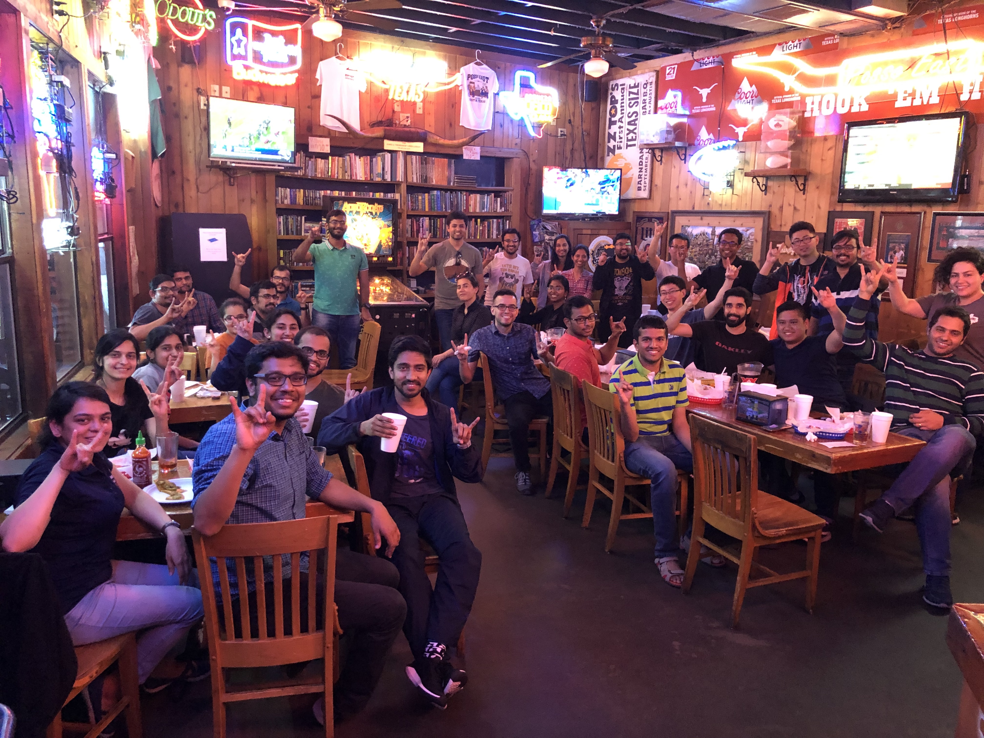
2019 Key Accomplishments
Meetings (month, topic, L31):
Officers Meeting with UT Faculty Advisors to brainstorm ideas and define the scope of our TEMS Graduate Student Chapter (2 meetings)
ECE Networking Social organized near UT campus (April 2019) → Attended by around 45 UT ECE graduate students and postdocs!
Drafting and approval of the TEMS Graduate Student Chapter’s Corporate Packet for corporate outreach and sponsorship!
Updating the Chapter’s webpage

Slide 4
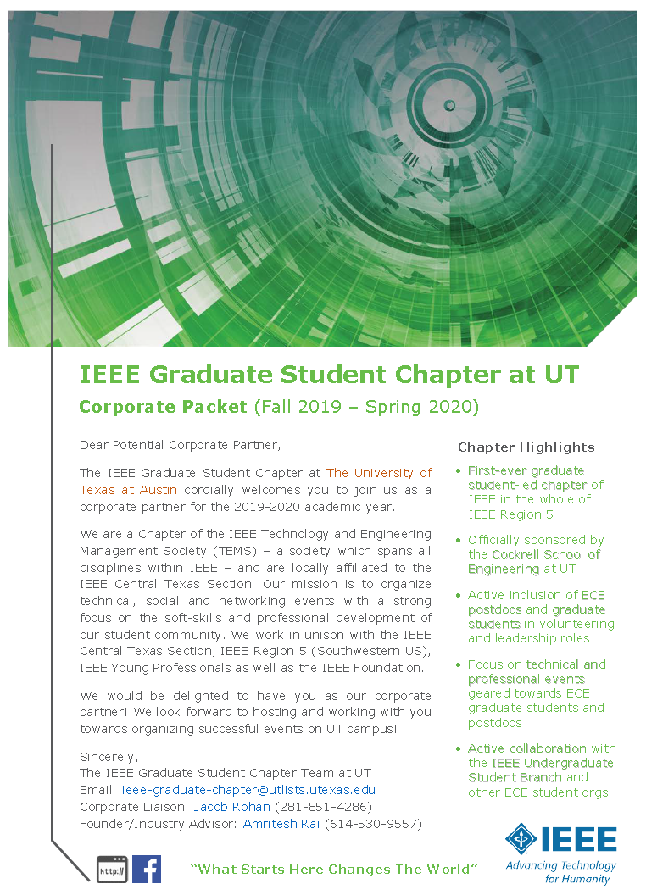
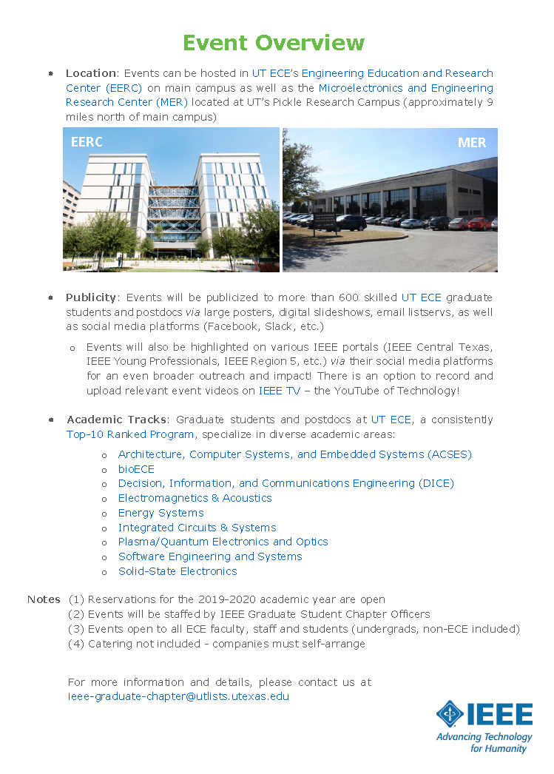
2019 Key Accomplishments

Slide 5
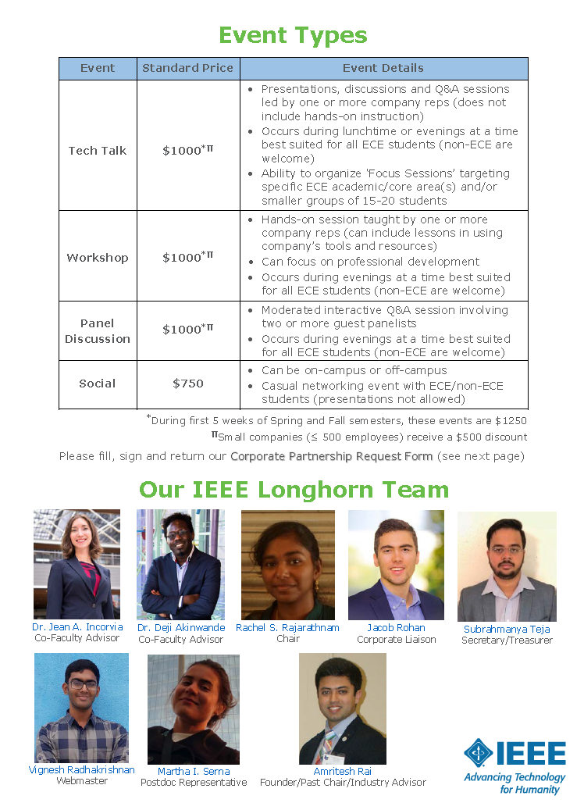
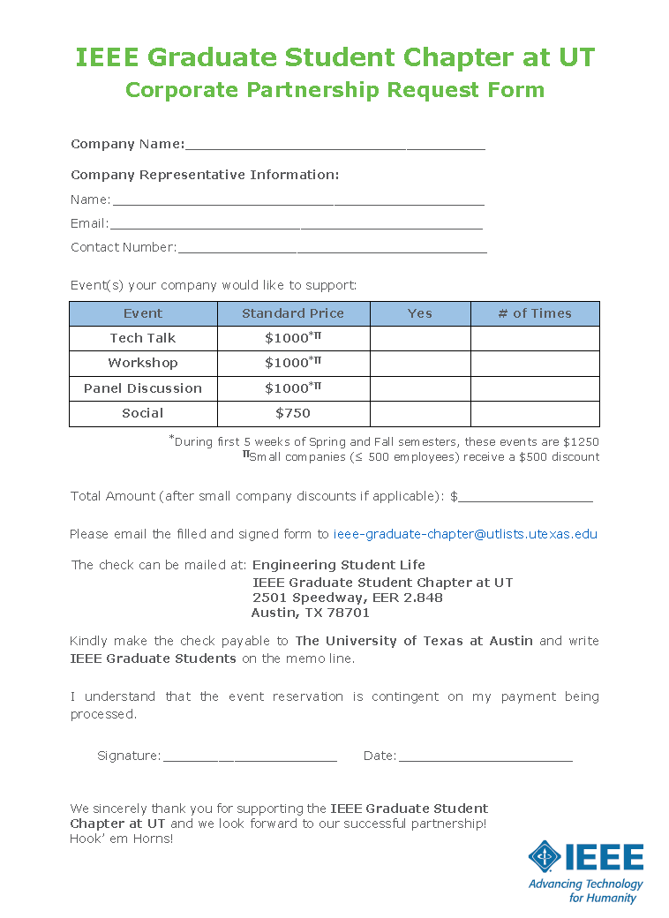
2019 Key Accomplishments

Slide 6
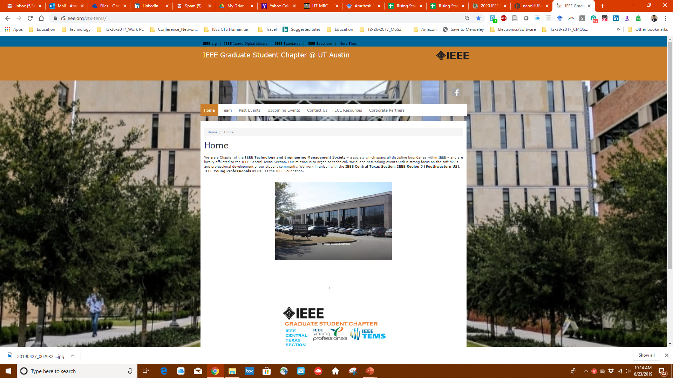
2019 Key Accomplishments
https://r5.ieee.org/ctx-tems
https://www.facebook.com/ieeectstemsgrads

Slide 7
2019 Chapter Vitality & Help Needed
Chapter Vitality Assessment (Strong, Ok, Need Improvement)
Examples: Attendance, Topical & Relevance, membership recruitment, finance, volunteers, ….
Strong start, looks OK, but need further improvement!
  Start organizing regular events (technical + non-technical) on UT campus for IEEE/ECE graduate students, postdocs, staff and faculty
  Engage and recruit more postdoc/graduate student volunteers
  Generate more funding through corporate and YP sponsorships
Top Help Needed/Issues
Examples: Attendance, Speakers, Training, Finance, Events, collaboration with STEM/Students/PACE/YP/Life Mem, …
Corporate/Professional speakers
Collaboration with CTS Undergraduate Student Branch and YPs
Finance!!!

Slide 8
CTS Leadership
CTS Officers
Chapters/Affinity
Standing Committees/Coordinators
Chair
Fawzi Behmann
Vice Chair – A
Heena Rathore
Vice Chair – SA
Nils Smith
Secretary
Treasurer
Bill Martino
Past Chair
Leslie Martinich
Student Branch
Student Branch Chapters
Strategic Plan
Policies and Procedures PARP
Awards and Recognition
Nomination Committee
Election Committee
FIN/Audit Committee
Membership Development
Electronics Communications
Website
Communications Portal
Conferences/Events
Section-Chapter Vitality Chair
K-12/STEM Educational Activities
Students Activities
Professional Activities – PACE
Outreach Program
Conferences/Events

